Slide 1
Notes:
Reference: teslamotors.com

Slide 2
Game-changing features
Torque in AC induction motors
“Throttle” response time in EVs
Battery design and capacity
Safety
Limitations

Slide 3
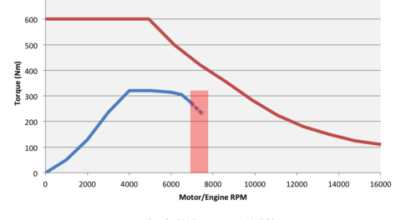
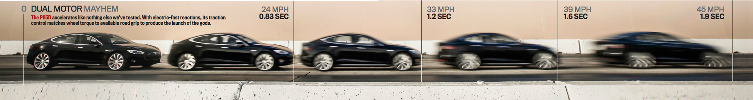
Torque
Notes:
Reference: http://www.teslamotors.com/forum/forums/saleen-tesla-gear-ratio?page=1
Reference: http://www.motortrend.com/roadtests/alternative/1411_2015_tesla_model_s_p85d_first_test/

Slide 4
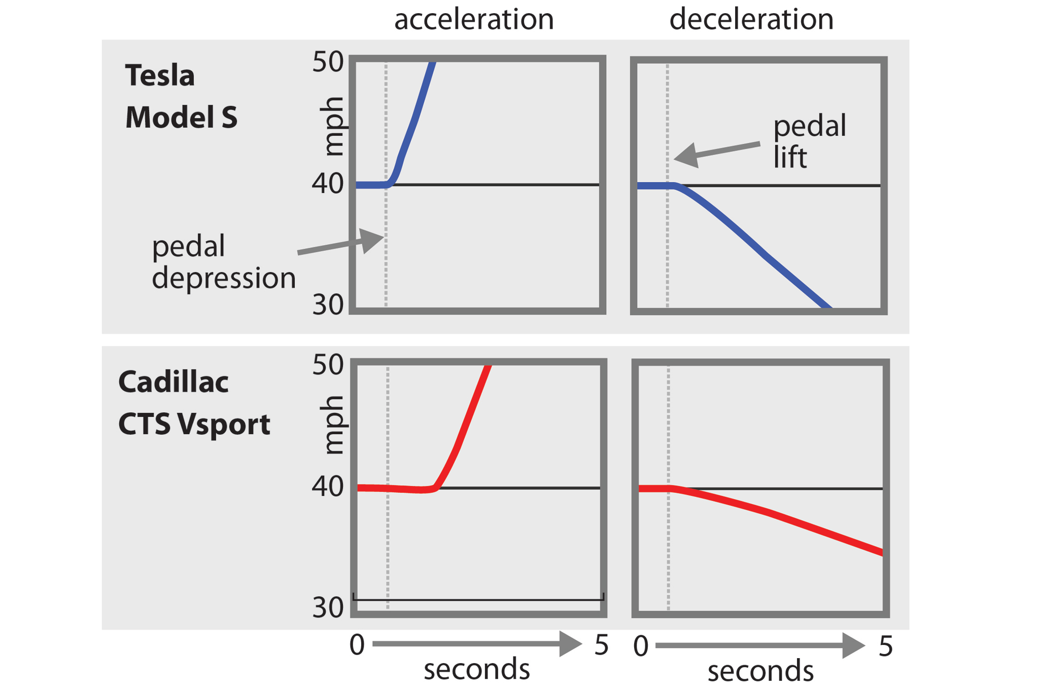
“Throttle” response time
Notes:
Reference: http://www.motortrend.com/roadtests/oneyear/alternative/1404_2013_tesla_model_s_p85_update_3/
Response time is nearly instant- makes the car feel like an extension of your body- very fun driving experience.
Electron fast throttle response time
More flexibility in component placement
Low center of gravity
Empty frunk for safety
Fast acceleration
Few moving parts

Slide 5
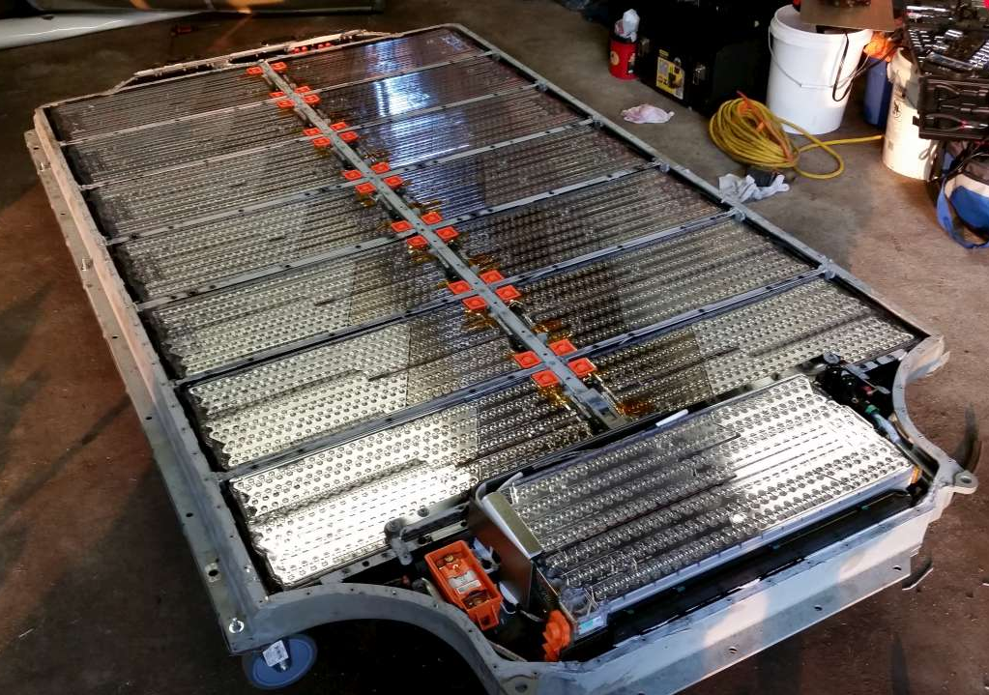
Battery
~7000 Li-ion cells by Panasonic
BMS controls cells and balances charge.
Worst degradation is time held high and low SOC.
For normal use charge to 80% and life will be significantly longer. 100% max range setting for road trips.
  Can’t keep a Leaf between 20% and 80% without range anxiety.
~10 year life
Coolant system allow fast charging 150 miles in first 20 minutes. 1 hour for full charge.
Small cells individually fused for safety.
Cylindrical cells packing leaves a lot of empty space- allows deformation during accident decreases puncture and decreases load transfer.
Safety gel sprayed onto all cells. In a fire, the gel expands into a foam, sealing air gaps around dangerous cell, cuts off air supply- no air, no fire!
Battery system under car for low C_{G}, even F-R weight distribution, and out of the way.
Notes:
Reference: http://hackaday.com/2014/09/13/tesla-model-s-battery-teardown/
Battery is heavy ~800 lbs.
Chassis aluminum to minimize weight, but still too heavy:
Total Curb weight: 4,647.3 lbs
Battery pack under the car
Low center of gravity
Even front back weight distribution
Clears up space under the hood as crumple zone

Slide 6
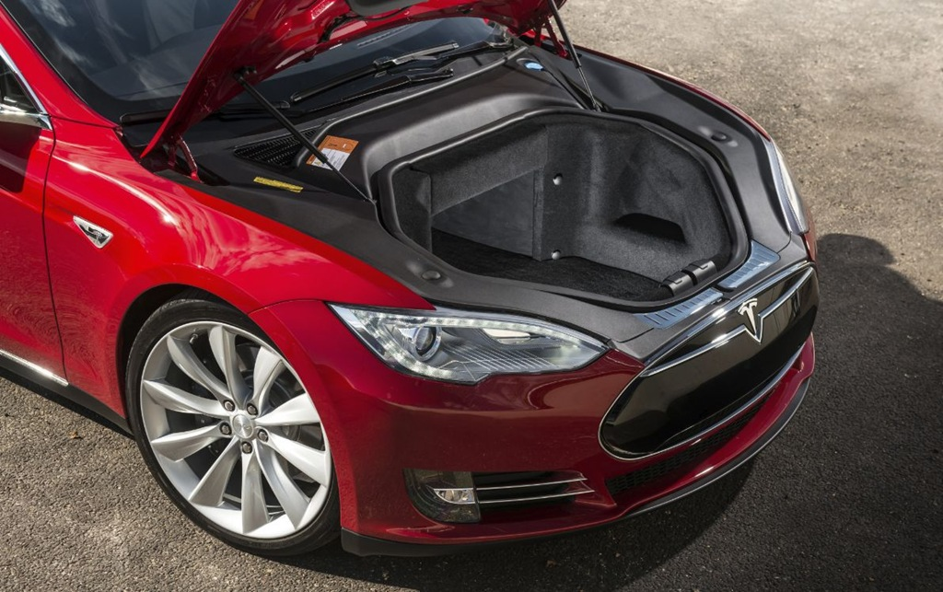
Safety
5-star NHTSA and NCAP safety rating.
Crash test video: https://www.youtube.com/watch?v=dz2FMfv-CSc
Low C_{G}, large foot-print, lots of empty space allows optimization for safety.
Notes:
Reference: https://www.youtube.com/watch?v=dz2FMfv-CSc

Slide 7
Limitations
Limited range and long charging time
  Supercharger- first 150 miles range in 20 minutes
  Battery-swapping
  Most trips are within the range of the car
Single gear limits top speed at 120 mph as motor can’t handle higher RPM
  Dual motor version: each motor is geared differently so it can go to 155 mph
Energy density of Li-ion battery much lower than gasoline→ not great for race cars
Tesla at the Nurburgring

Slide 8
Pro
Con
Fast response time
Instant torque
Low C_{G}
Small component footprint
  400 hp motor the size of a water melon
  Empty frunk
Electronic controlled AWD easy
No transmission (single fixed gear. reverse current, reverse drive)
Few moving parts
Long refueling time
Limited range
Low energy density of battery→heavy
Complex electronics needed to control battery
Cost
Not for race track
Notes:
No more gas stations (especially nice in a snow storm)
No more oil changes, air filter changes, transmission fluid changes etc etc
Quieter roads
No emissions at the tailpipe- can be driven indoors
Regenerative breaking saves energy, and minimizes use of mechanical breaks- prolonging breakpad life and decreasing break dust.

Slide 9
P85D first drive video: https://www.youtube.com/watch?v=JyxTey3ADAA
Notes:
Reference: https://www.youtube.com/watch?v=JyxTey3ADAA

Slide 10
Records and awards
Lowest C_{D} production car when released (0.24).
Longest-range production EV.
Consumer Reports highest rating in their history 99/100.
MotorTrend Car of the Year 2013
Safest crash-tested car on the road (NHTSA when considering all subcategories).
P85D fastest accelerating 4 door sedan (0-60 in 3.1s). 691 hp.

